Slide 1

Chemical Exposure in California Cosmetics: A CDPH Analysis (2009-2020)
An analysis of chemical exposure from cosmetics. This is based on CDPH data collected between 2009 and 2020.
Done by: Eman Aljowair, Shaikha Mohammed

Slide 2
CDPH's Safe Cosmetics Program: Overview and Goals
The Safe Cosmetics Program was started by the CDPH. It aims to monitor and regulate cosmetic ingredients. The goal is to minimize health risks by making such information available to consumers.
Monitoring
Regulation
Education
Continuous monitoring of cosmetic products. Focus on identifying potentially harmful chemicals.
Developing and enforcing regulations. Regulations limit the use of unsafe chemicals in cosmetics.
Educating the public about safe cosmetic choices. Promoting transparency in the cosmetic industry.

Slide 3

Key Chemicals of Concern Identified by CDPH
CDPH has flagged several chemicals as concerning. These are commonly found in cosmetic products.
1
Titanium dioxide
2
Carbon Black
- Commonly found in cosmetics.
- Inhalation risks and carcinogenic effects.
Potential toxicity and carcinogenic
3
Retinol Esters
- Widely used in Anti-aging treatments.
- Causes skin sensitivity and pregnancy toxicity concerns .

Slide 4




Demographic Disparities in Cosmetic Chemical Exposure
Certain demographics face higher chemical exposure. These disparities often correlate with product use.
Women use more cosmetic products than men. They thus experience higher overall exposure levels.
People working closely with cosmetics like skin care and nail salons workers .
Workers in industrial settings.

Slide 5
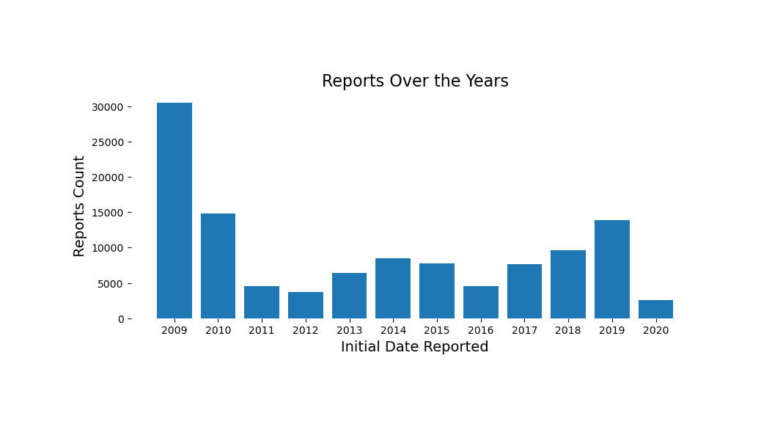
Did the chemicals report decreased over the years?

Slide 6
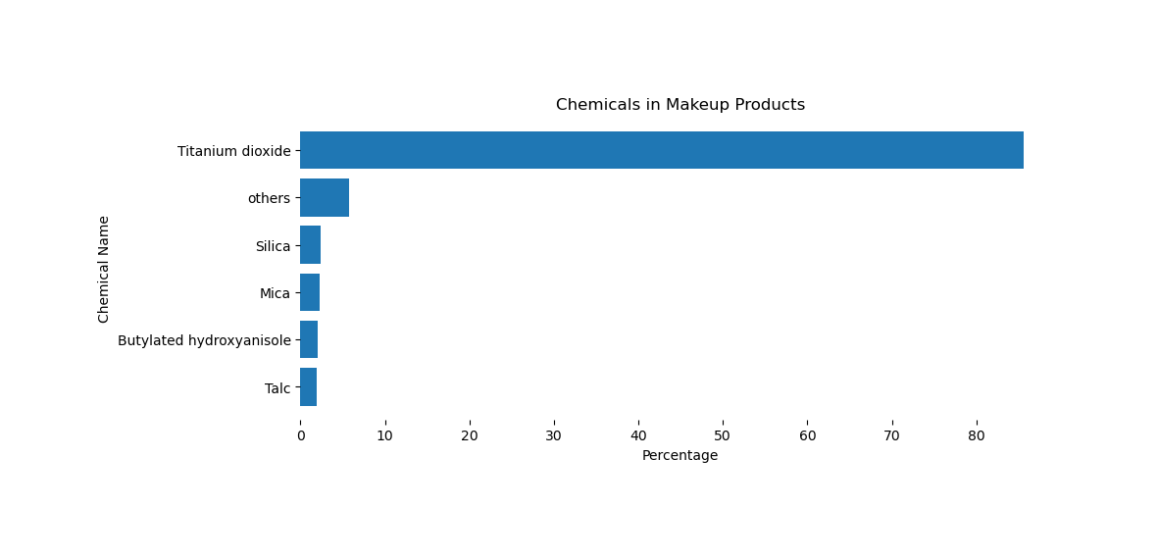
Which chemicals are more present per product prime category?

Slide 7
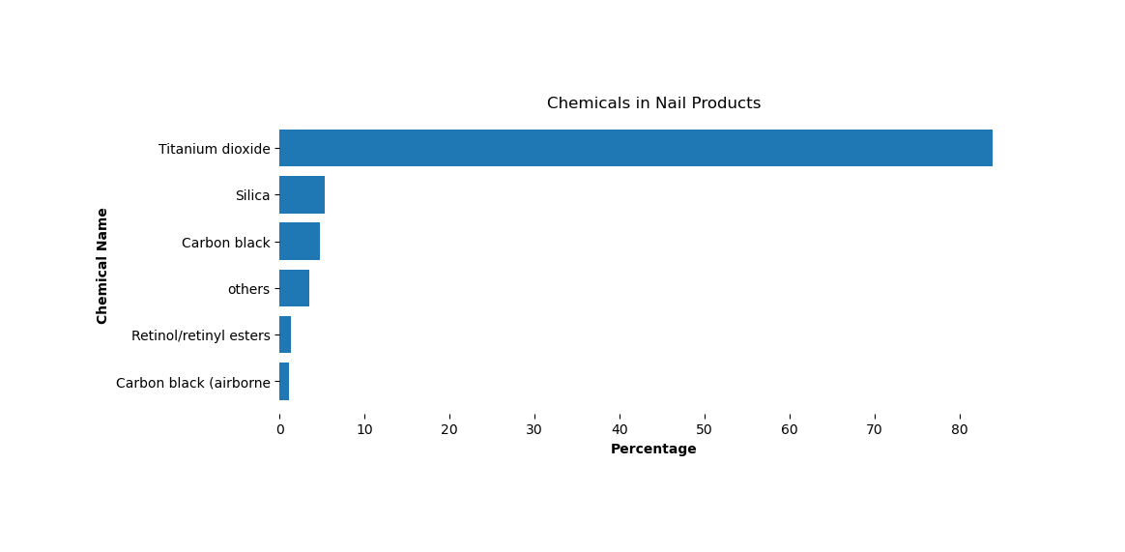
Which chemicals are more present per product prime category?

Slide 8
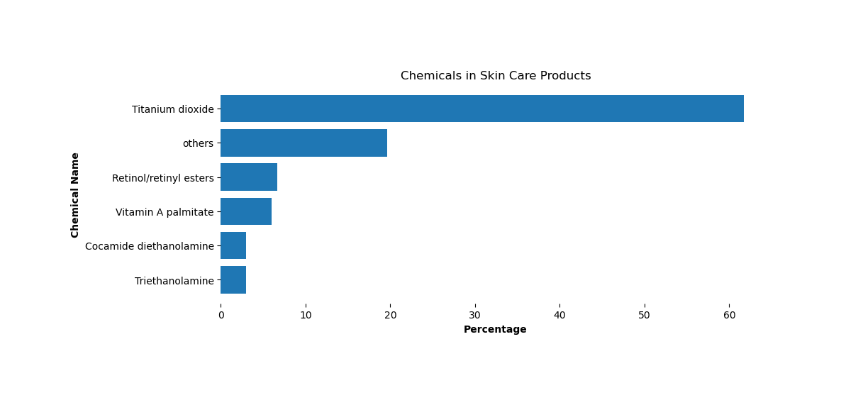
Which chemicals are more present per product prime category?

Slide 9
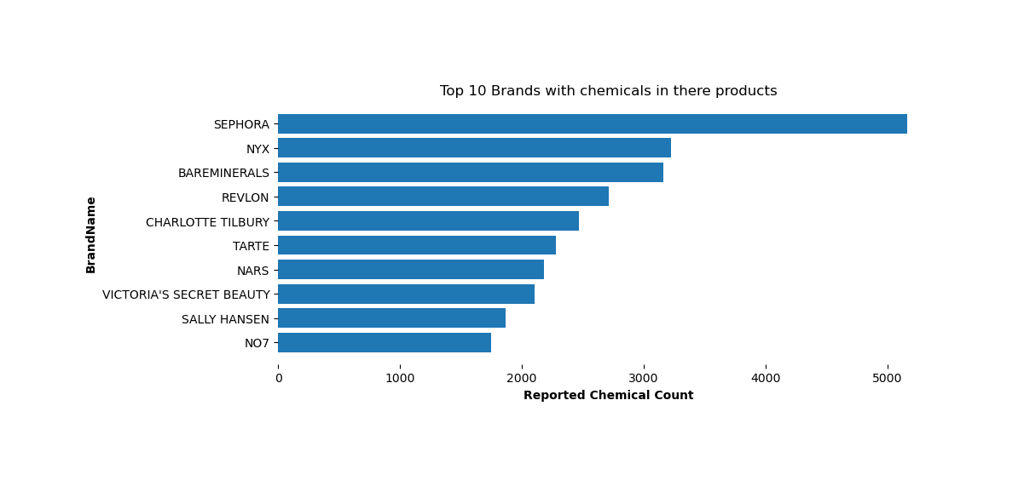
What are the top 10 brands with the most chemicals in their products?

Slide 10
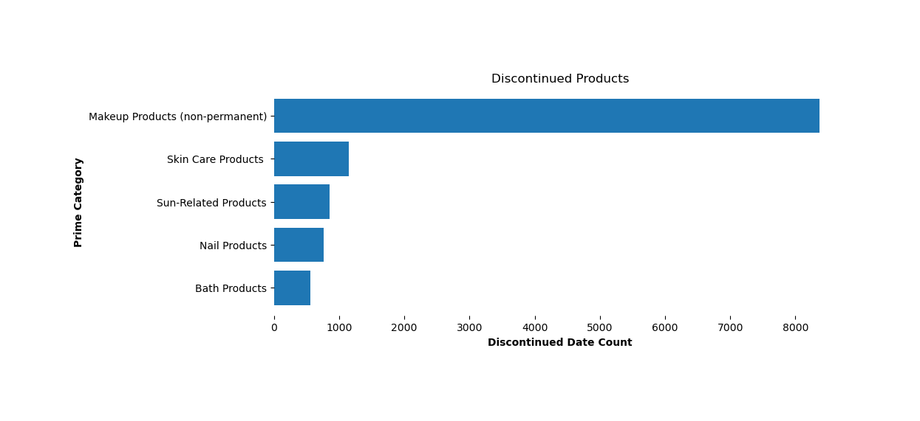
Which prime category contains most of the products that have been discontinued?

Slide 11
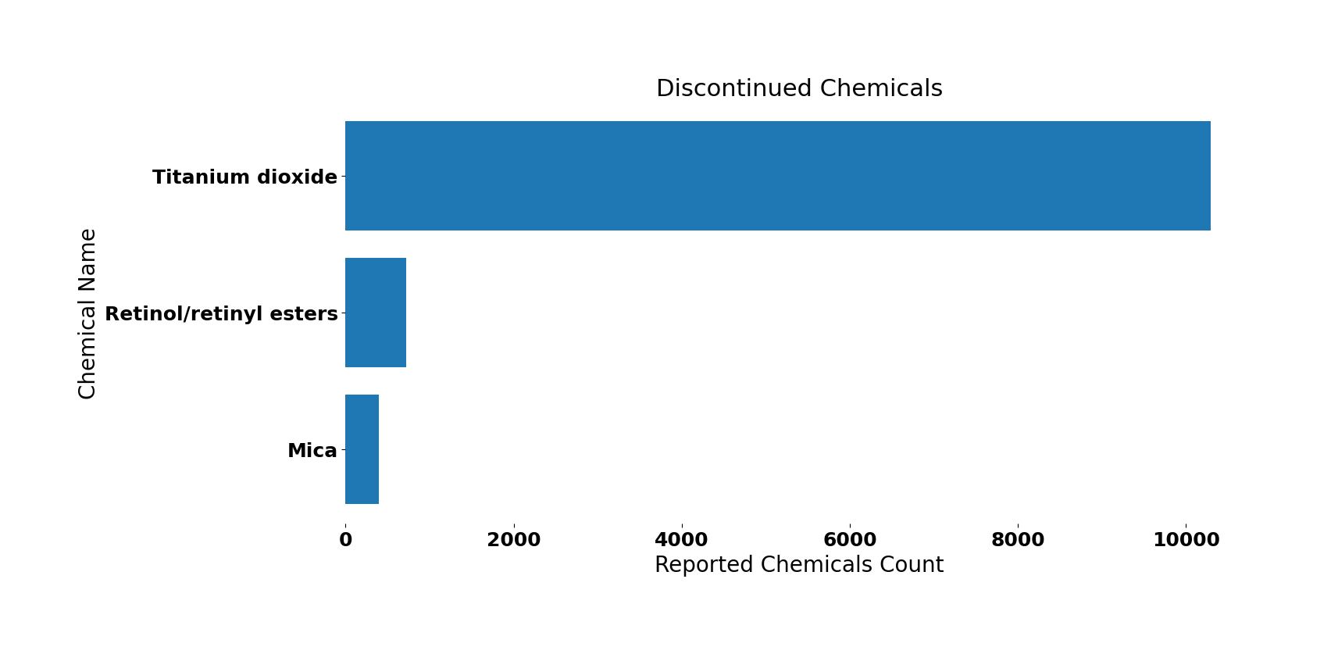
What chemicals are commonly found in discontinued products?

Slide 12
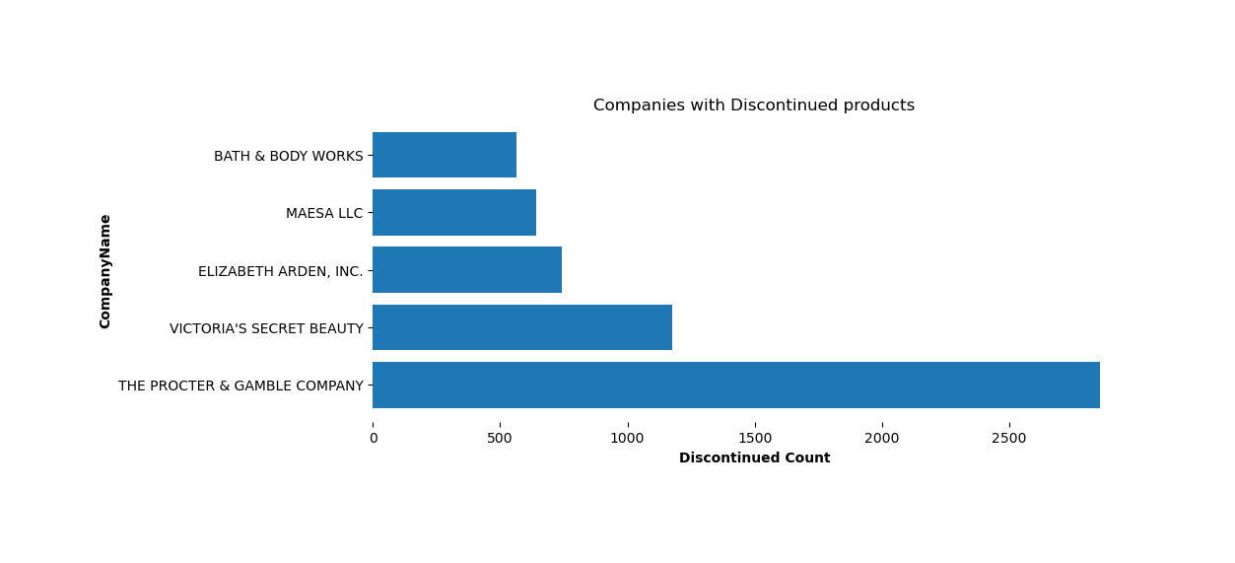
Which companies have discontinued products, and which ones haven’t at all?

Slide 13



Which companies have discontinued products, and which ones haven’t at all?
Out of all 604 companies 415 company did not discontinue any of there products.
Huda beauty, L’oreal USA and NYX los angeles,inc are some famous examples.

Slide 14




Regulatory Actions and Industry Responses
Regulations have influenced industry practices. Companies have responded to public concerns.
There is more pressure for safe formulas.
Legislation
Reformulation
Transparency
California laws restrict certain chemicals.
Companies reformulate products. They remove harmful substances.
Increased transparency in ingredient listing.

Slide 15

Public Health Implications and Future Research Needs
Chemical exposure links to health effects are emerging. Further research is needed to assess long-term risks.
Cancer Risks
Reproductive Health
Some chemicals may increase cancer risk.
Endocrine disruptors affect reproduction.
Developmental Effects
Chemicals impact child development.

Slide 16



Summary: Protecting Consumers from Harmful Cosmetic Chemicals
Protecting consumers from harm requires collective action. Consumers must be informed. Industry needs to be proactive. Regulatory bodies must be vigilant.
2
Proactive Industry
1
Informed Consumers
Vigilant Regulation
3

Slide 17
Thank you

